Slide 1
Single-cell analysis for HEK293T cell lines
Feng Tian
5/20/2018
Notes:
大家好，今天我总结一下目前的一些进展。

Slide 2
Background
Input: scRNA-seq data
Output: expression profile and modules
De-multiplex (fastq format)
Read mapping (Gene model guided: Gencode v26)
Expression profile (UMI)
Modules
Quality control
Notes:
主要针对从测序数据到细胞分类和调控网络的过程，具体分为测序样本拆分，回帖数据，基因表达量计算，质量控制以及之后的细胞分类与调控网络构建。

Slide 3
Input data
Pair-end reads for human HEK293T cells (96 cells * 10 samples)
Sample Name | % GC | Length | M Seqs
PD10_XXL_293-B9-1_S32_L007_R1_001 | 41% | 151 bp | 258.2
PD10_XXL_293-B9-1_S32_L007_R2_001 | 41% | 151 bp | 258.2
PD10_XXL_293-B9-2_S33_L008_R1_001 | 43% | 151 bp | 255.9
PD10_XXL_293-B9-2_S33_L008_R2_001 | 42% | 151 bp | 255.9
PR10_XXL_293-B9-10_S4_L004_R1_001 | 41% | 151 bp | 269.9
PR10_XXL_293-B9-10_S4_L004_R2_001 | 40% | 151 bp | 269.9
PR10_XXL_293-B9-3_S17_L002_R1_001 | 42% | 151 bp | 249.1
PR10_XXL_293-B9-3_S17_L002_R2_001 | 41% | 151 bp | 249.1
PR10_XXL_293-B9-4_S1_L001_R1_001 | 41% | 151 bp | 274.3
PR10_XXL_293-B9-4_S1_L001_R2_001 | 40% | 151 bp | 274.3
PR10_XXL_293-B9-5_S2_L002_R1_001 | 40% | 151 bp | 257.8
PR10_XXL_293-B9-5_S2_L002_R2_001 | 39% | 151 bp | 257.8
PR10_XXL_293-B9-6_S18_L003_R1_001 | 41% | 151 bp | 235.2
PR10_XXL_293-B9-6_S18_L003_R2_001 | 40% | 151 bp | 235.2
PR10_XXL_293-B9-7_S3_L003_R1_001 | 42% | 151 bp | 252.4
PR10_XXL_293-B9-7_S3_L003_R2_001 | 40% | 151 bp | 252.4
PR10_XXL_293-B9-8_S19_L004_R1_001 | 41% | 151 bp | 248.4
PR10_XXL_293-B9-8_S19_L004_R2_001 | 40% | 151 bp | 248.4
PR10_XXL_293-B9-9_S20_L005_R1_001 | 41% | 151 bp | 250.7
PR10_XXL_293-B9-9_S20_L005_R2_001 | 40% | 151 bp | 250.7
Notes:
通过barcode信息拆分每个细胞数据并获得clean data。

Slide 4
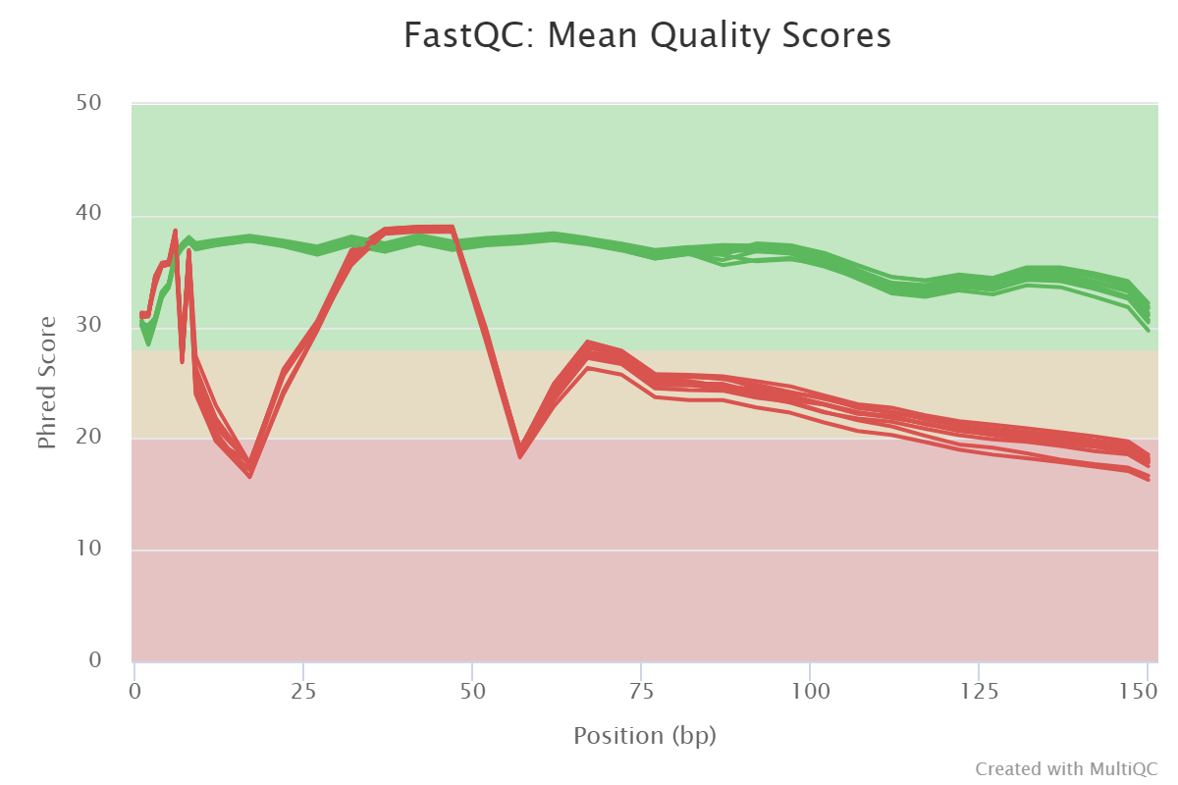
Input data
Sequence quality
Read1
Read2
Notes:
通过barcode信息拆分每个细胞数据并获得clean data。

Slide 5
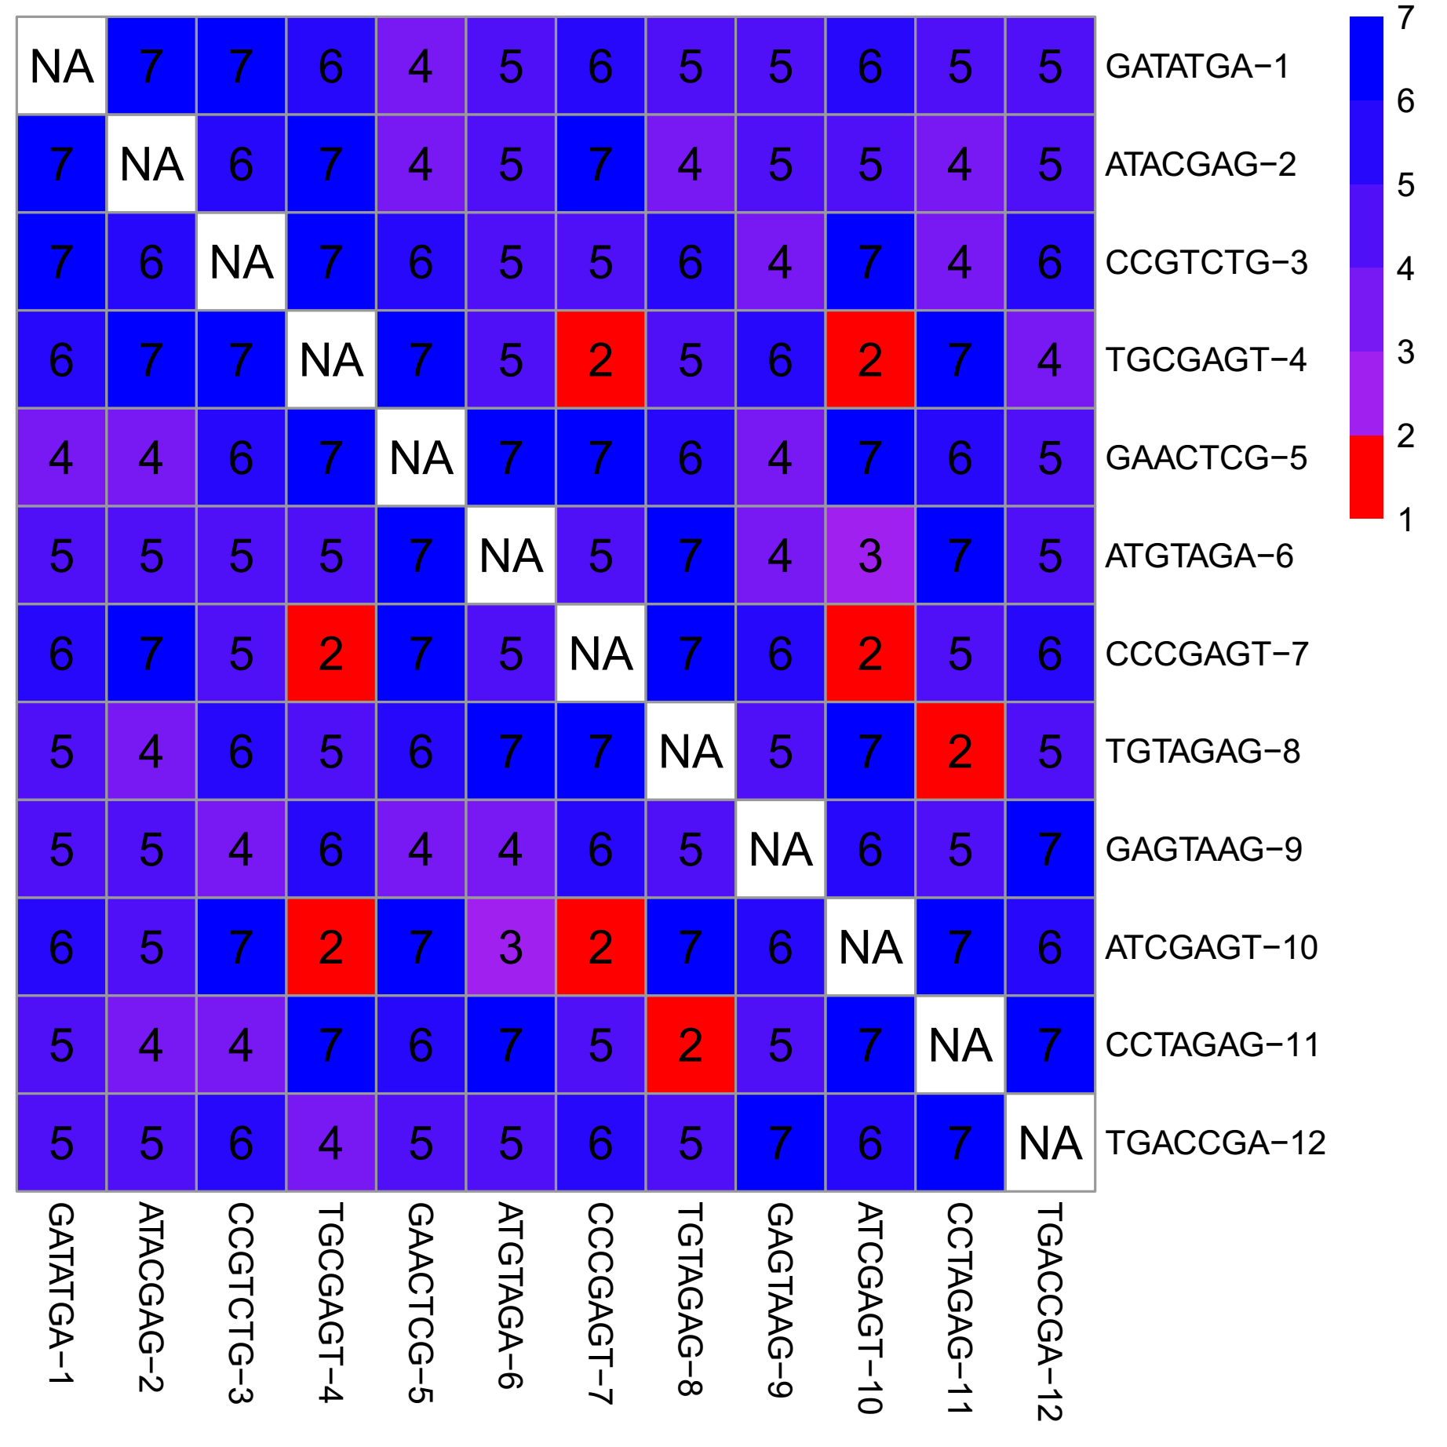
De-multiplex data (from 1 sample to 96 cells)
1. Allow mismatch in barcode recognition (outer barcodes) e.g. AATATGA -> GATATGA (A C G T N)
“TGCGAGT-4” and “CCCGAGT-7”
Conflict:
“CGCGAGT” and “TCCGAGT”
320 (4 * 7 bp * 12 seq - 4 * 4)
Notes:
通过barcode信息拆分每个细胞数据并获得clean data。

Slide 6
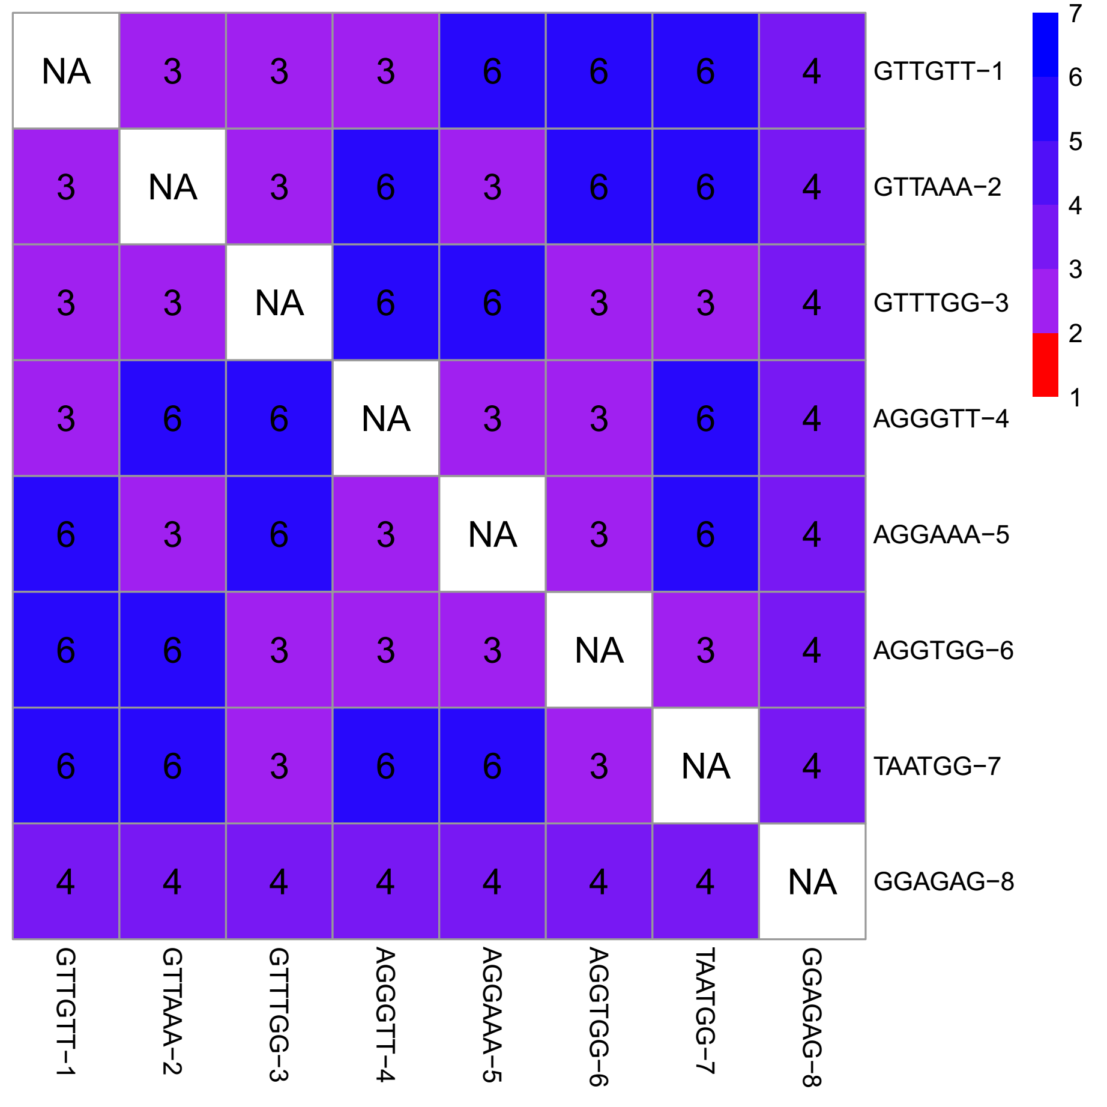
De-multiplex data (from 1 sample to 96 cells)
1. Allow mismatch in barcode recognition (inner barcodes)
192 (4 * 6 bp * 8 seq - 0)
Notes:
通过barcode信息拆分每个细胞数据并获得clean data。

Slide 7
De-multiplex data (from 1 sample to 96 cells)
2. Filter incorrect Unique molecular identifiers (UMIs)
HBDVHBDVHBDVHBDVHBDV
Degenerative sequences
GACTGACTGACTGACTGACT
The Read2 with >=3 incorrect base pairs (p<0.05) will be removed.
Sequencing method from Alec et al.
Notes:
通过barcode信息拆分每个细胞数据并获得clean data。

Slide 8
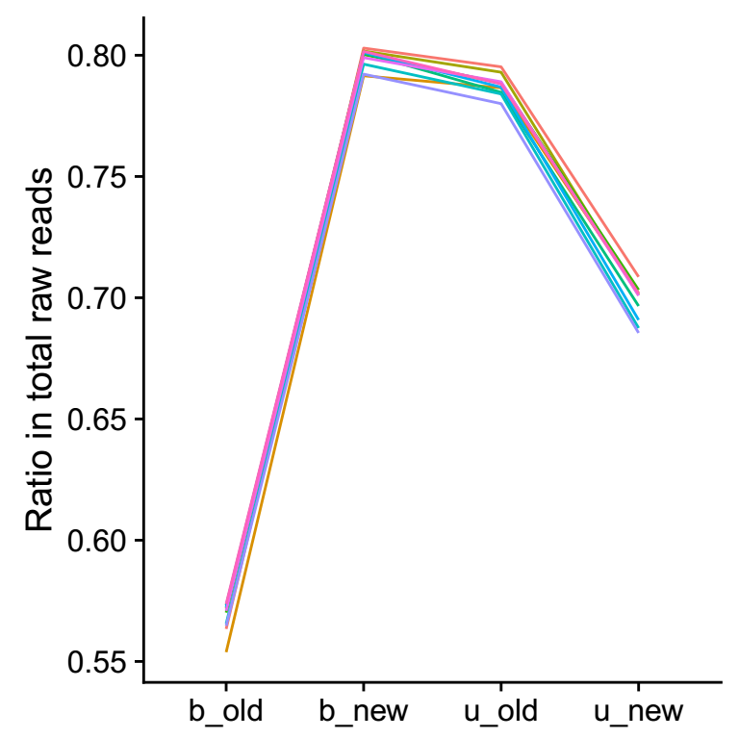
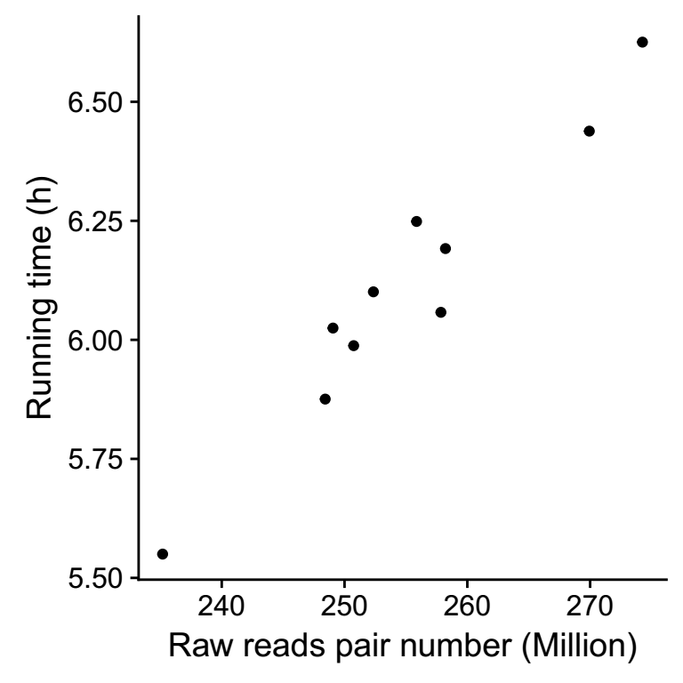
De-multiplex data (from 1 sample to 96 cells)
3. Estimation
Notes:
通过barcode信息拆分每个细胞数据并获得clean data。

Slide 9
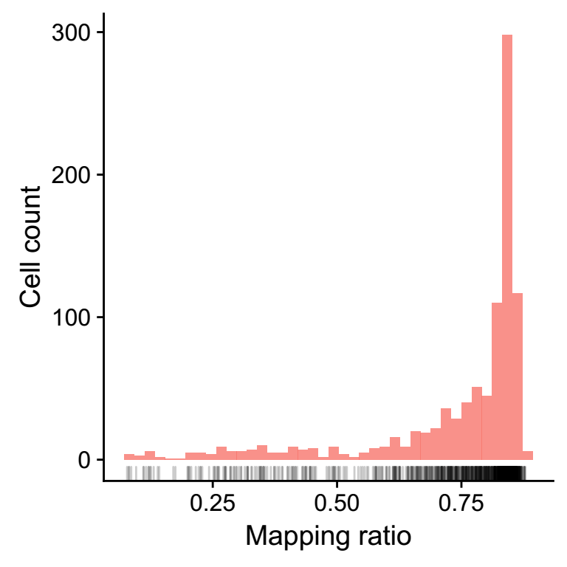
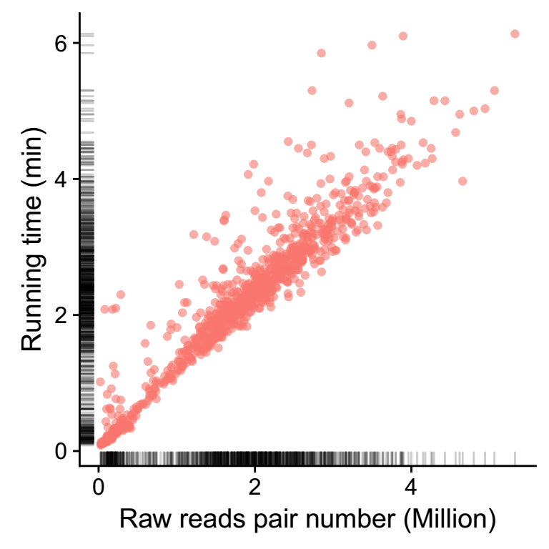
Reads mapping (hg38)
Less than 1h for analysis (4 CPU/ cell)
Hisat2 (v2.1.0) with default settings.
Notes:
然后将reads回帖至基因组。

Slide 10
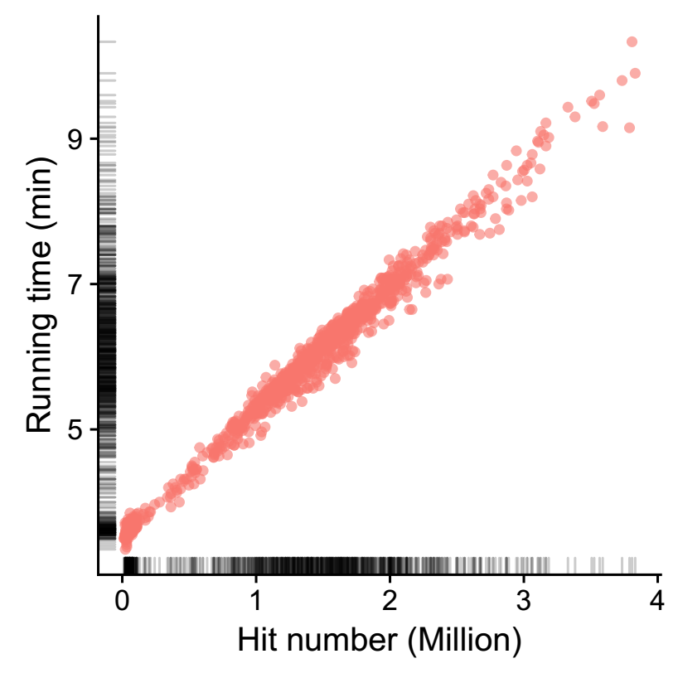
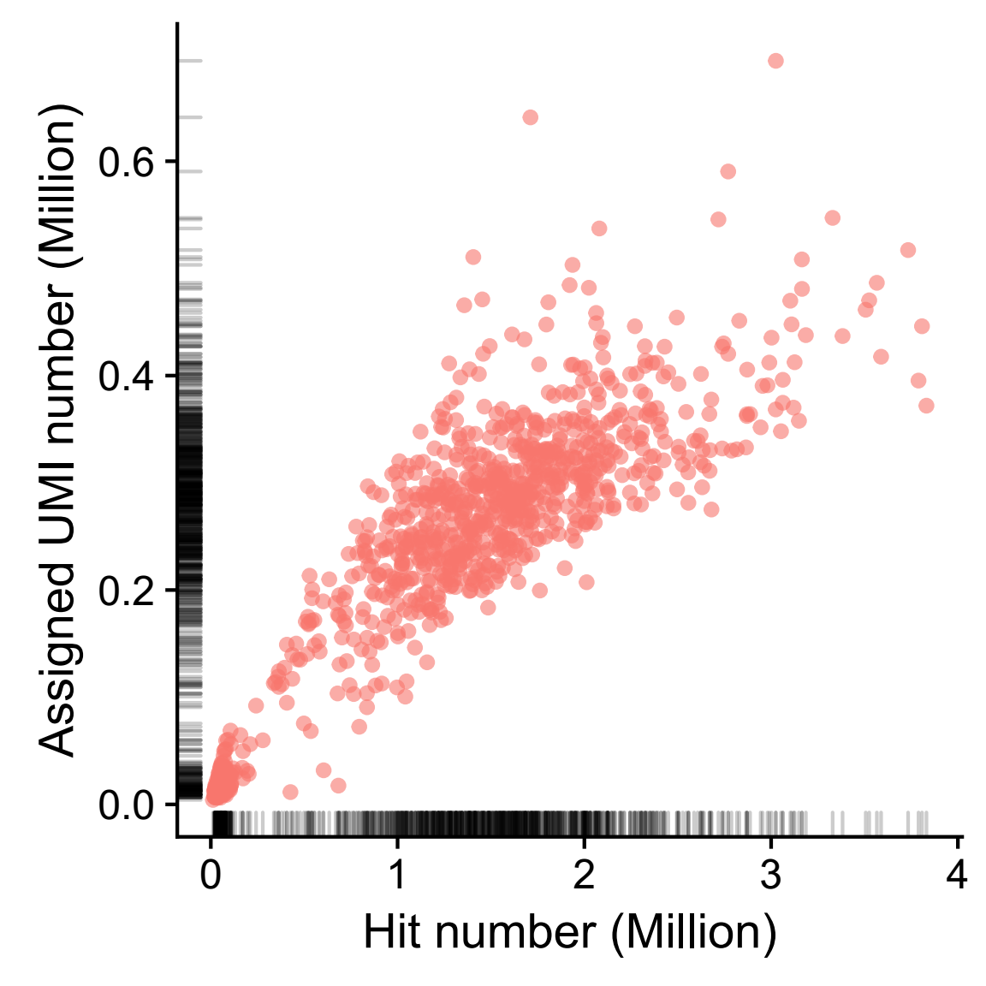
Expression calling (UMI counts)
Less than 15min for each cell
HT-Seq (v0.9.0) with options of “-f sam”.
Notes:
然后根据gene注释信息和每个细胞的reads回帖结果计算各个基因的表达量，根据UMI信息去除duplicate，从而获得了不同细胞的不同基因的表达数据。

Slide 11
Quality control for cells and genes
For cells (960 -> 778):
Clean reads number (>=0.5 Million)
Alignment ratio (>=60%)
Detected Genes number (>7000 & <12000)
Expression level of mitochondrial genes (<10%)
For genes (56227 -> 27420):
Detected in >=3 cells
Notes:
在计算表达量之后，我通过如下条件筛选细胞和基因，
筛选细胞方面，
筛选基因方面，

Slide 12
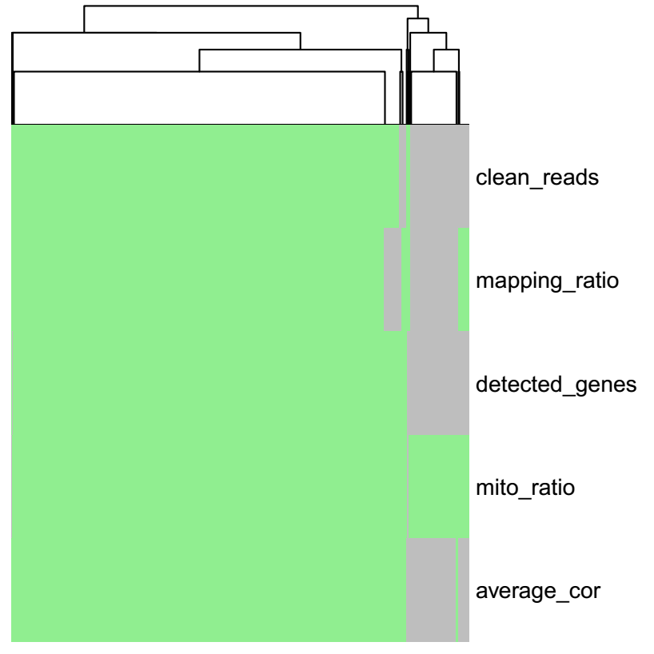
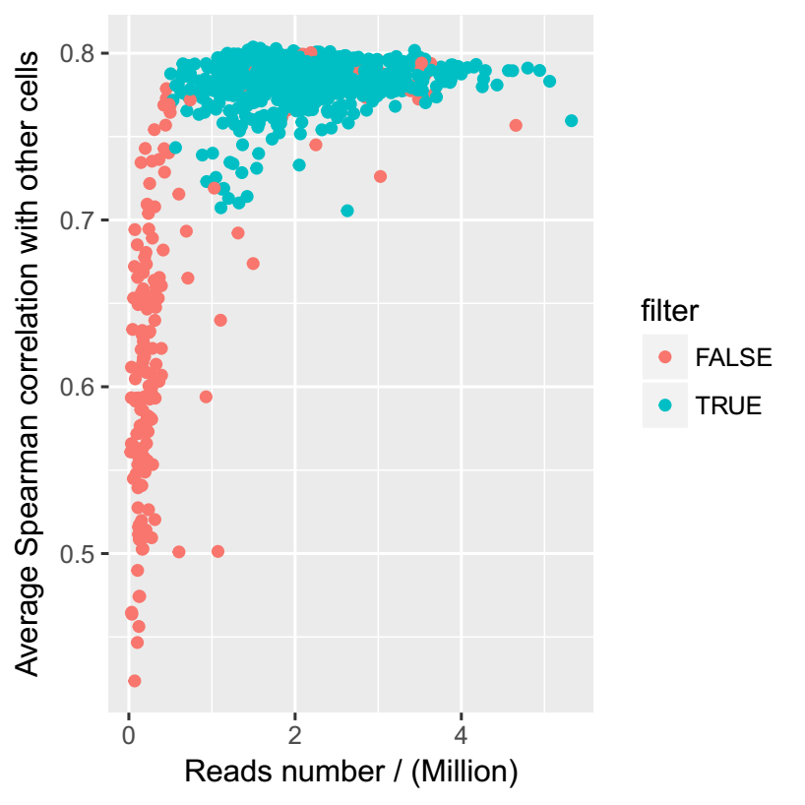
Quality control for cells and genes
Cells were filtered in several criteria consistently.

Slide 13
Expression similarity (1798 cells)
Dataset | Source | Cells | Experiment contributor | Pipeline | Median of detected genes/cell
Alec et al. | Harvard | 717 | Alec Chapman | Harvard | 7,080
PKU384 | PKU | 303 | Alec Chapman | PKU | 9,649
PKU960 | PKU | 778 | Wenping Ma | PKU | 1,0163

Slide 14
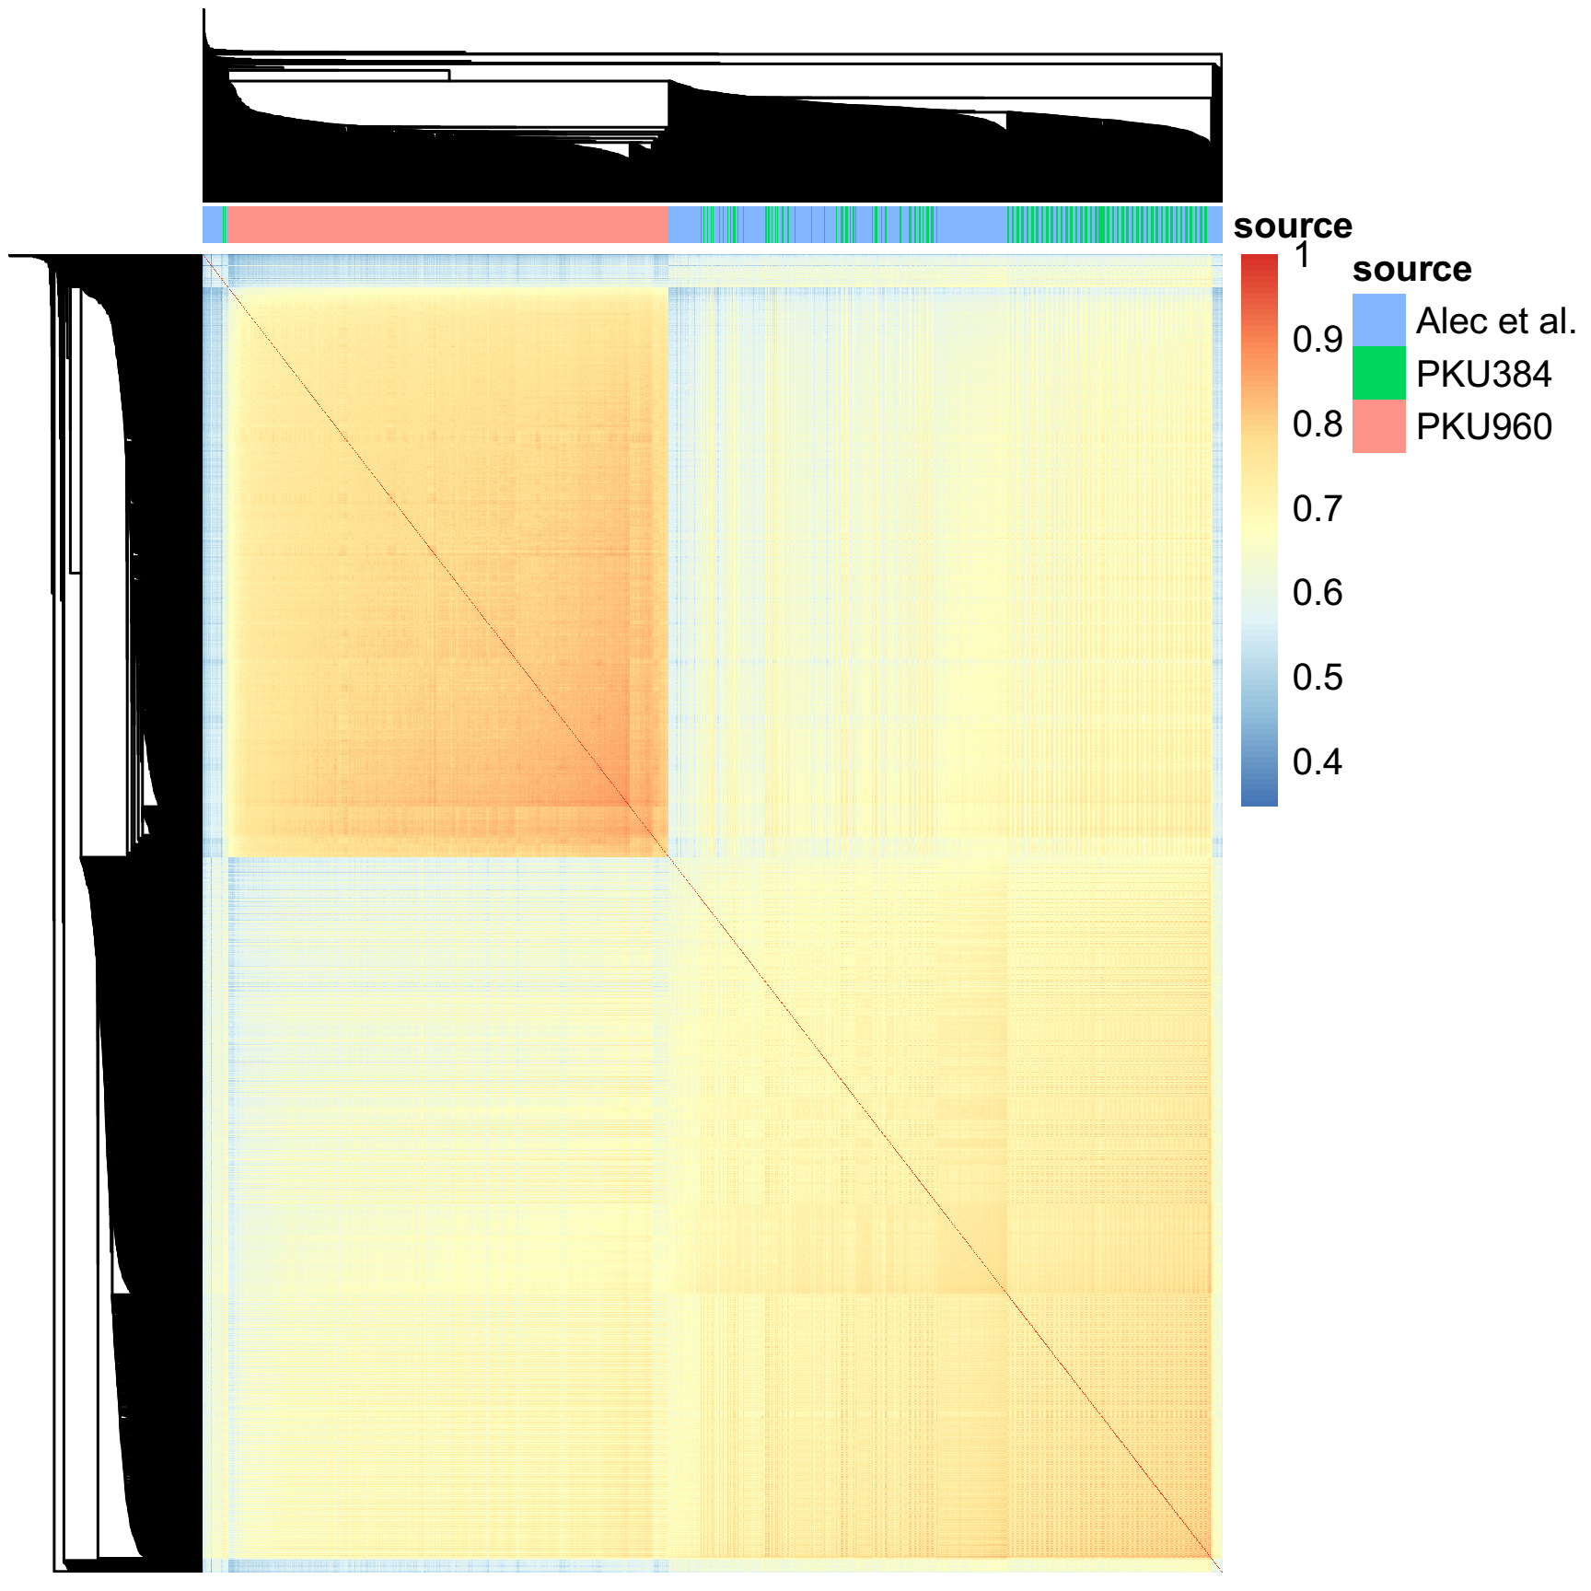
Expression similarity (1798 cells)
Distance between cells: 1 - Spearman correlation (10391 intersected genes)
Cluster method: “average”
The PKU384 and PKU960 expression tables showed distinct patterns.

Slide 15
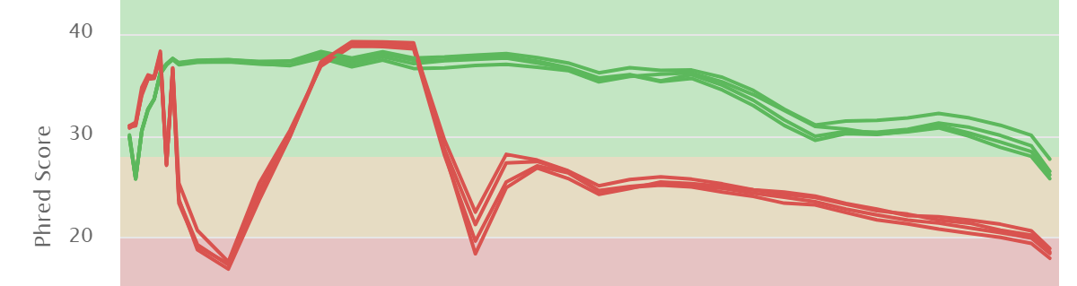
Comparison (PKU384 and PKU960)
1. Reads quality of rawdata
PKU384
PKU960

Slide 16
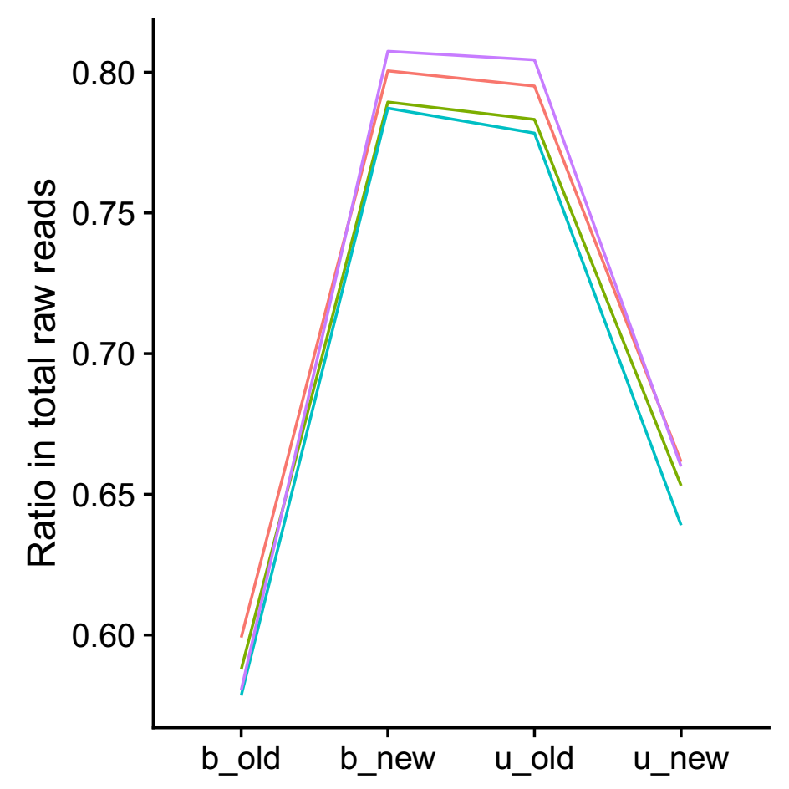
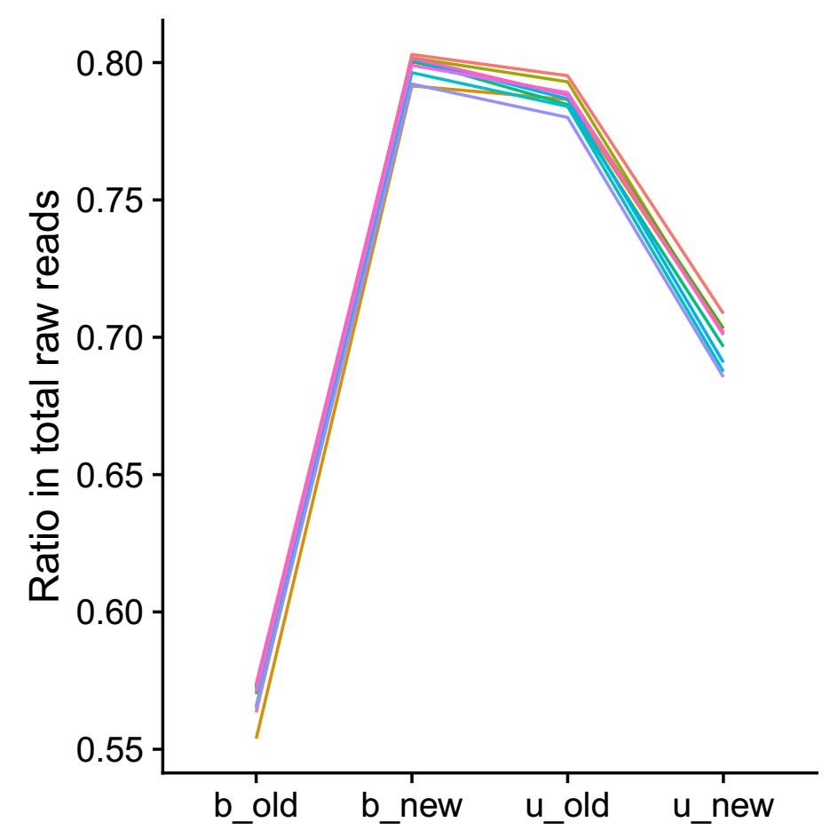
Comparison (PKU384 and PKU960)
2. Barcodes recognition and UMIs filtering
PKU384
PKU960

Slide 17
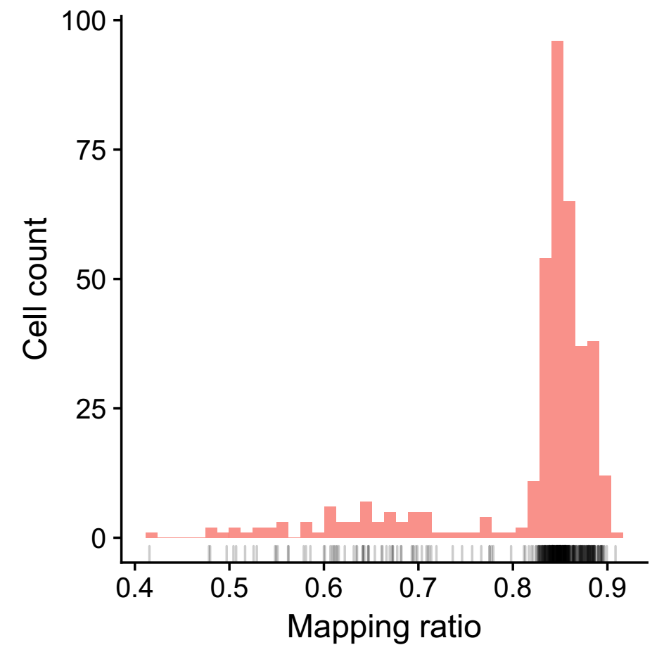

Comparison (PKU384 and PKU960)
3. Reads mapping
PKU384
PKU960

Slide 18
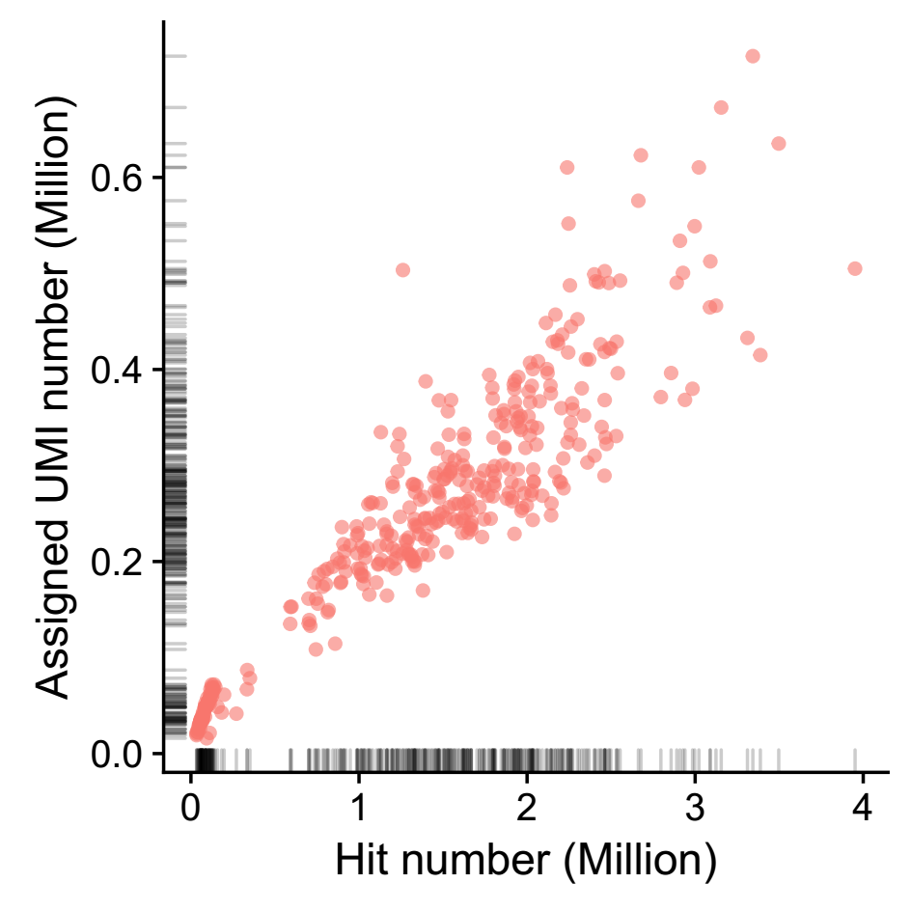

Comparison (PKU384 and PKU960)
4. Expression
PKU384
PKU960

Slide 19
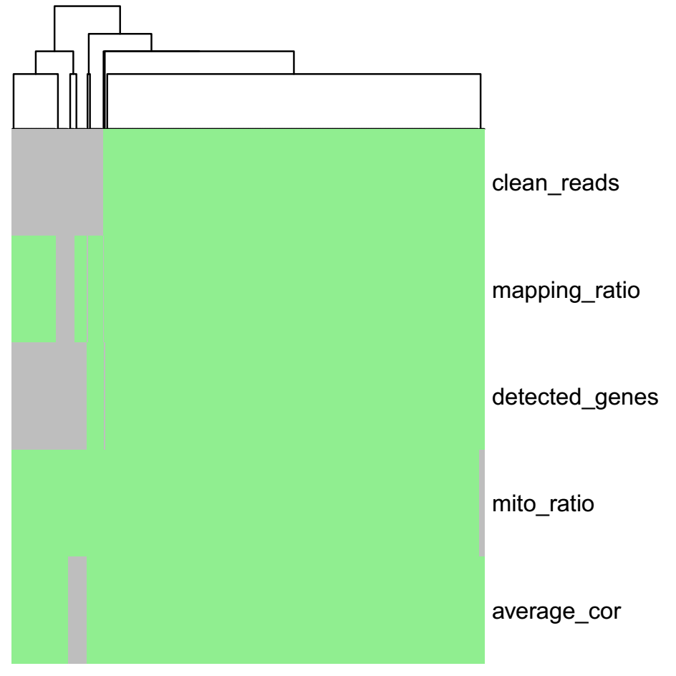
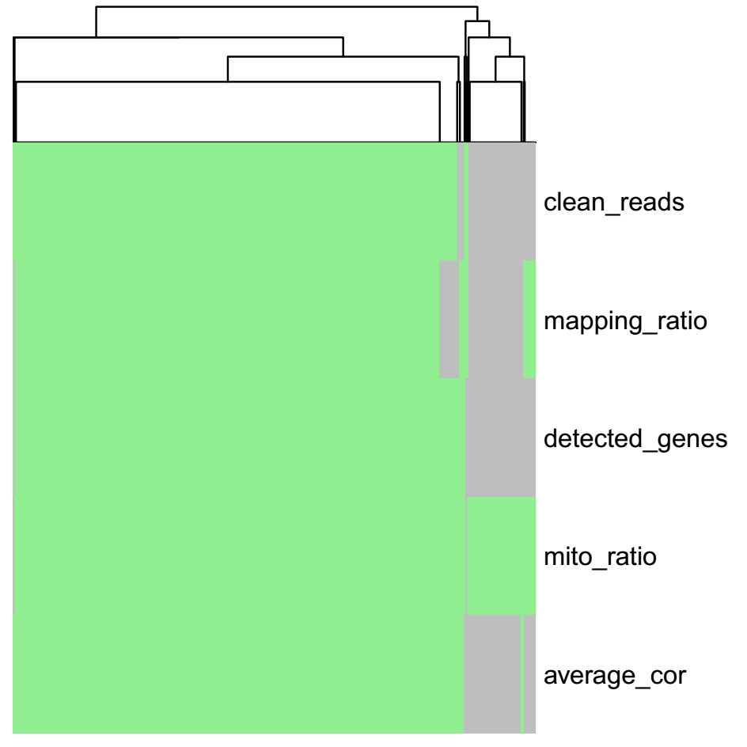
Comparison (PKU384 and PKU960)
5. Filtering
PKU384
PKU960

Slide 20
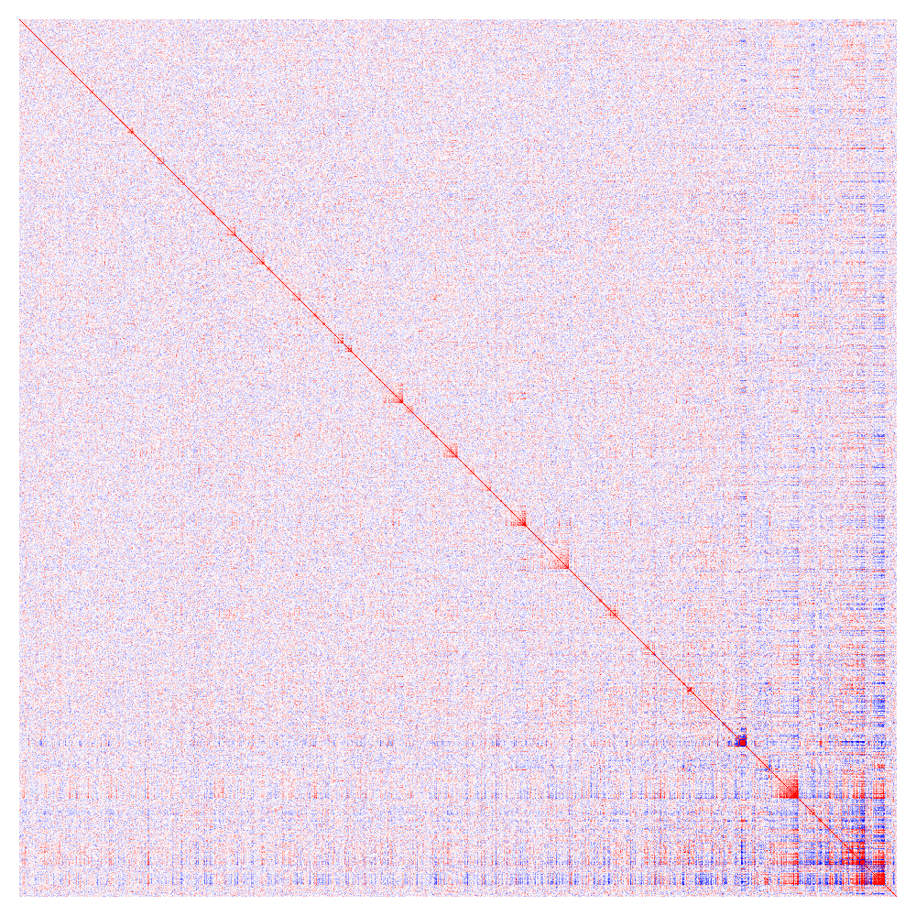
Co-expression modules (717 cells from Alec et al.)
Dataset: 6142 genes in 174 modules
(11303 genes were used)

Slide 21
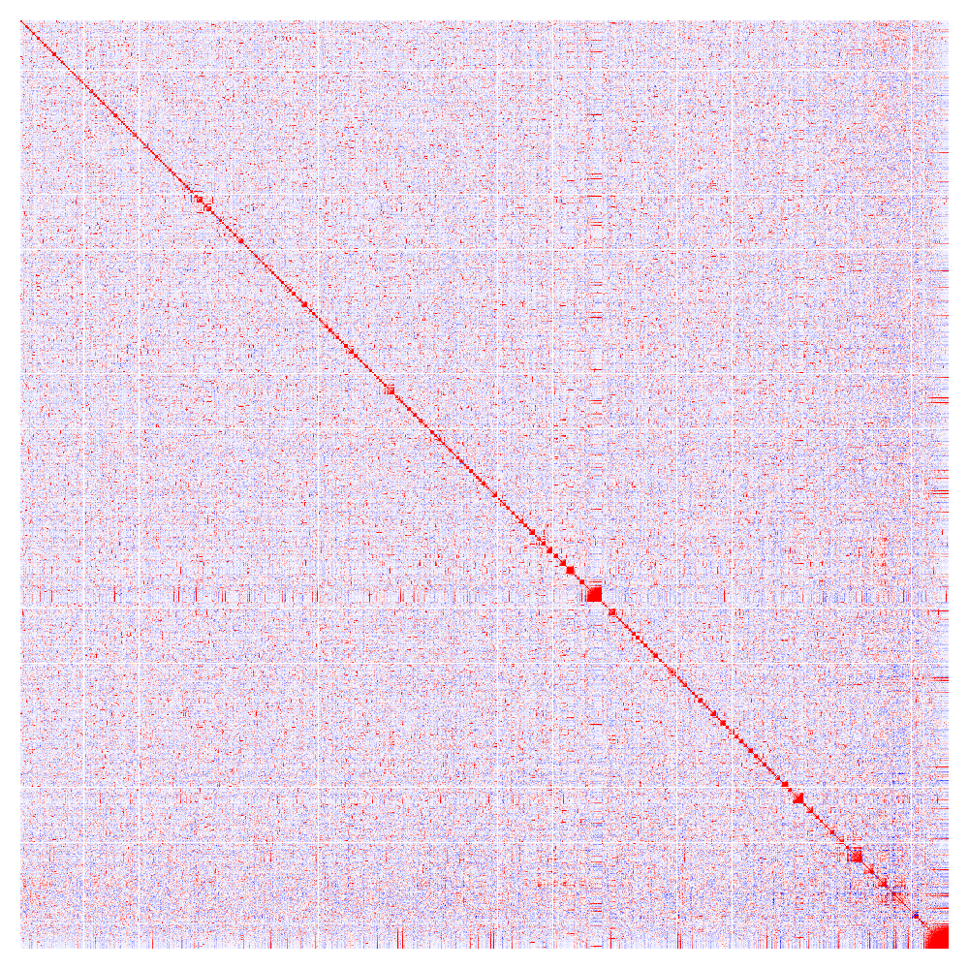
Co-expression modules (303 cells from PKU384)
Dataset: 21989 genes in 298 modules

Slide 22
Co-expression modules (717 cells from Alec et al.)
Annotate modules using different libraries
Rectome_2016: manually curated and peer-reviewed pathway
WikiPathways_2016: the curation of biological pathways
KEGG_2016: pathway
ChEA: transcription factor (TF) regulation inferred from ChIP-X
ENCODE_and_ChEA_Consensus_TFs_from_ChIP-X: TF regulation
…
Adjusted p-value <= 0.05

Slide 23
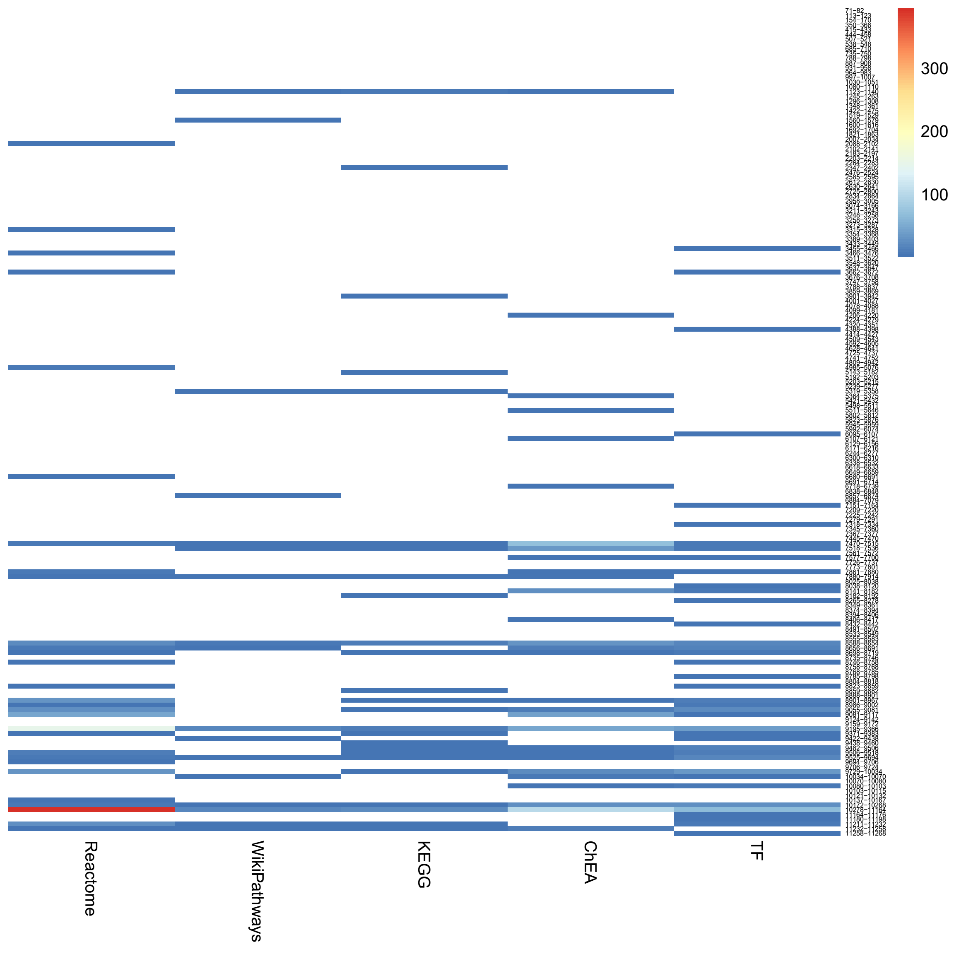
Co-expression modules (717 cells from Alec et al.)
64 / 174 modules were annotated by at least 1 enriched terms
29 17 25 29 39
Adjusted p-value <= 0.05

Slide 24
Co-expression modules (717 cells from Alec et al.)
Label 41 modules based on enriched terms
ID | Label | Genes with label in module | Genes in all annotation | Adjusted p-value
1 | Cell Cycle | 62 | 566 | 2.38E-49
2 | Infectious disease | 89 | 348 | 5.13E-40
3 | Cytosolic tRNA aminoacylation | 11 | 24 | 1.19E-19
4 | rRNA modification in the nucleus | 9 | 58 | 2.63E-09
5 | Cell Cycle | 10 | 566 | 7.48E-08
6 | ATF6-alpha activates chaperone genes | 3 | 10 | 1.12E-06
7 | Generic Transcription Pathway | 7 | 812 | 4.42E-06
8 | Formation of a pool of free 40S subunits | 4 | 96 | 7.78E-05
9 | Smooth Muscle Contraction | 4 | 33 | 0.000139566
10 | Golgi Associated Vesicle Biogenesis | 7 | 54 | 0.000161158
11 | Formation of Senescence-Associated Heterochromatin Foci (SAHF) | 3 | 17 | 0.000214384
12 | Cell Cycle, Mitotic | 10 | 462 | 0.000306627
13 | Major pathway of rRNA processing in the nucleolus | 4 | 166 | 0.000988306
14 | Calcium Regulation in the Cardiac Cell | 3 | 149 | 0.001440322
15 | Downregulation of TGF-beta receptor signaling | 3 | 26 | 0.002034171

Slide 25
Co-expression modules (717 cells from Alec et al.)
Label 41 modules based on enriched terms (continued)
ID | Label | Genes with label in module | Genes in all annotation | Adjusted p-value
16 | Gene Expression | 6 | 1631 | 0.002066147
17 | Generic Transcription Pathway | 4 | 812 | 0.002088408
18 | Cellular response to heat stress | 3 | 96 | 0.003998636
19 | Ribosome biogenesis in eukaryotes | 3 | 89 | 0.004350399
20 | XBP1(S) activates chaperone genes | 7 | 53 | 0.004924274
21 | Gene Expression | 7 | 1631 | 0.006666666
22 | ER to Golgi Anterograde Transport | 6 | 131 | 0.0072283
23 | ECM proteoglycans | 3 | 55 | 0.007631763
24 | Metabolic pathways | 7 | 1239 | 0.008055291
25 | Metabolic pathways | 7 | 1239 | 0.010292799
26 | Integrated Pancreatic Cancer Pathway | 3 | 192 | 0.012167041
27 | Type I diabetes mellitus | 3 | 43 | 0.01347896
28 | Regulation of actin cytoskeleton | 3 | 214 | 0.018716688
29 | The role of GTSE1 in G2/M progression after G2 checkpoint | 3 | 59 | 0.026064455
30 | Regulation of RAS by GAPs | 3 | 67 | 0.028986487

Slide 26
Co-expression modules (717 cells from Alec et al.)
Label 41 modules based on enriched terms (continued)
ID | Label | Genes with label in module | Genes in all annotation | Adjusted p-value
31 | Purine metabolism | 3 | 176 | 0.029111926
32 | Signaling by ERBB4 | 3 | 330 | 0.029322342
33 | Metabolism of lipids and lipoproteins | 3 | 659 | 0.031141127
34 | Disease | 3 | 725 | 0.033292629
35 | Signaling Pathways in Glioblastoma | 3 | 83 | 0.034323132
36 | Gene Expression | 6 | 1631 | 0.0365669
37 | Ribosome | 3 | 137 | 0.038391086
38 | Metabolism of proteins | 4 | 1074 | 0.047481222
39 | Metabolic pathways | 3 | 1239 | 0.047495476
40 | PCP/CE pathway | 3 | 91 | 0.049313165
41 | Ubiquitin mediated proteolysis | 3 | 137 | 0.049878561

Slide 27
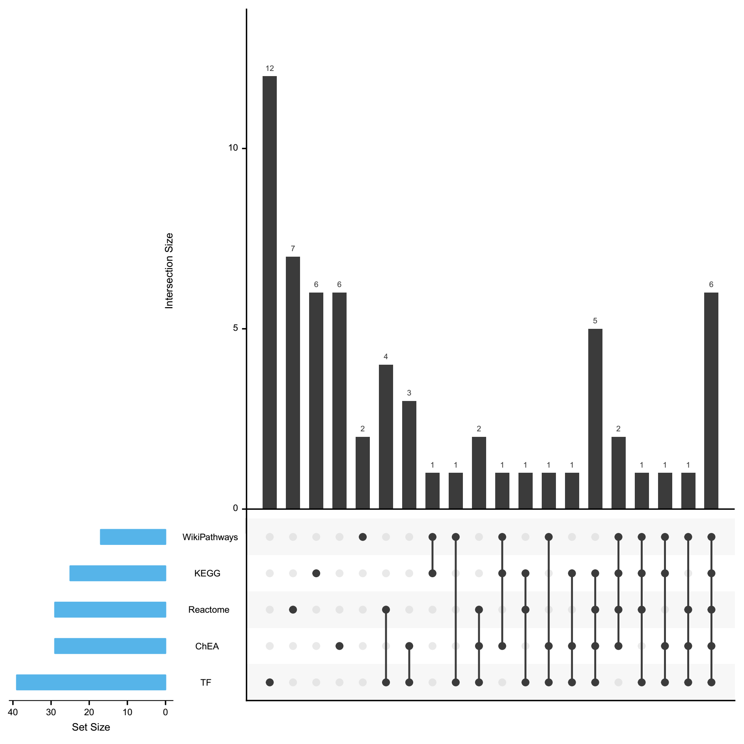
Co-expression modules (717 cells from Alec et al.)
Dataset: 6142 genes in 174 modules

Slide 28
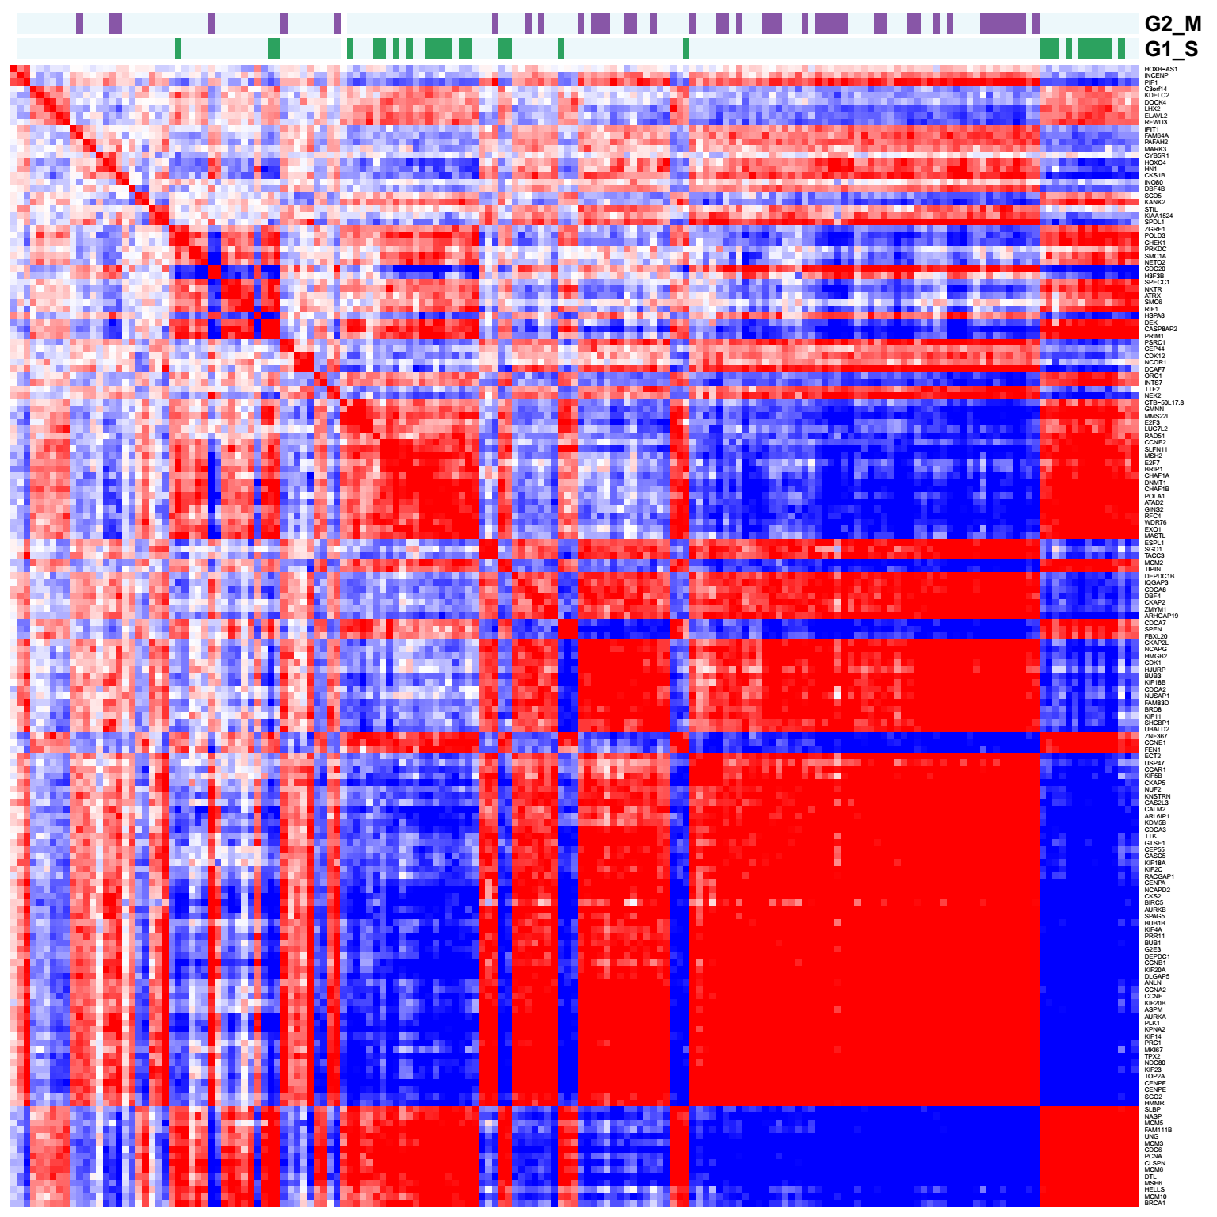
Cell-cycle-related module (171 genes): 9195-9366
Cell cycle marker gene list from Macosko et al., 2015

Slide 29
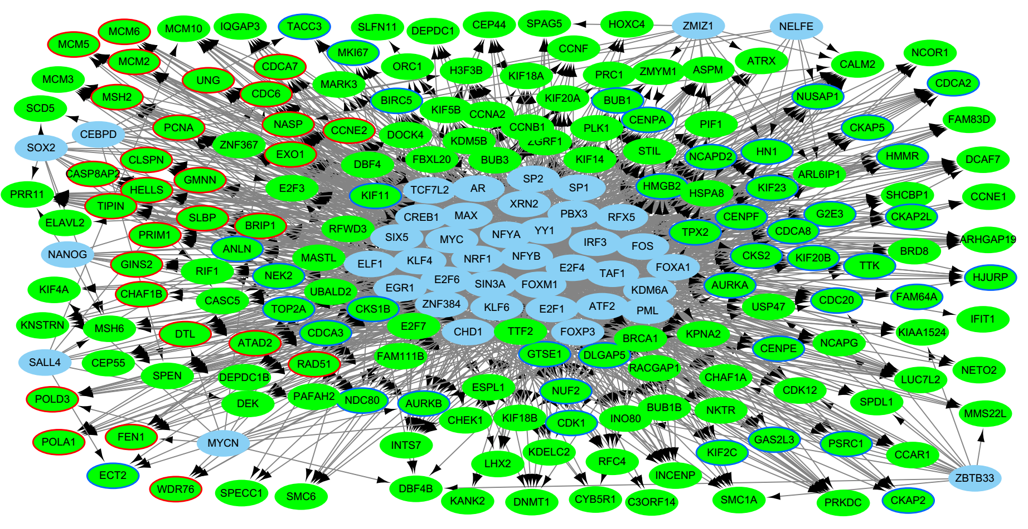
Cell-cycle-related module (167 / 171 genes): 9195-9366

Slide 30
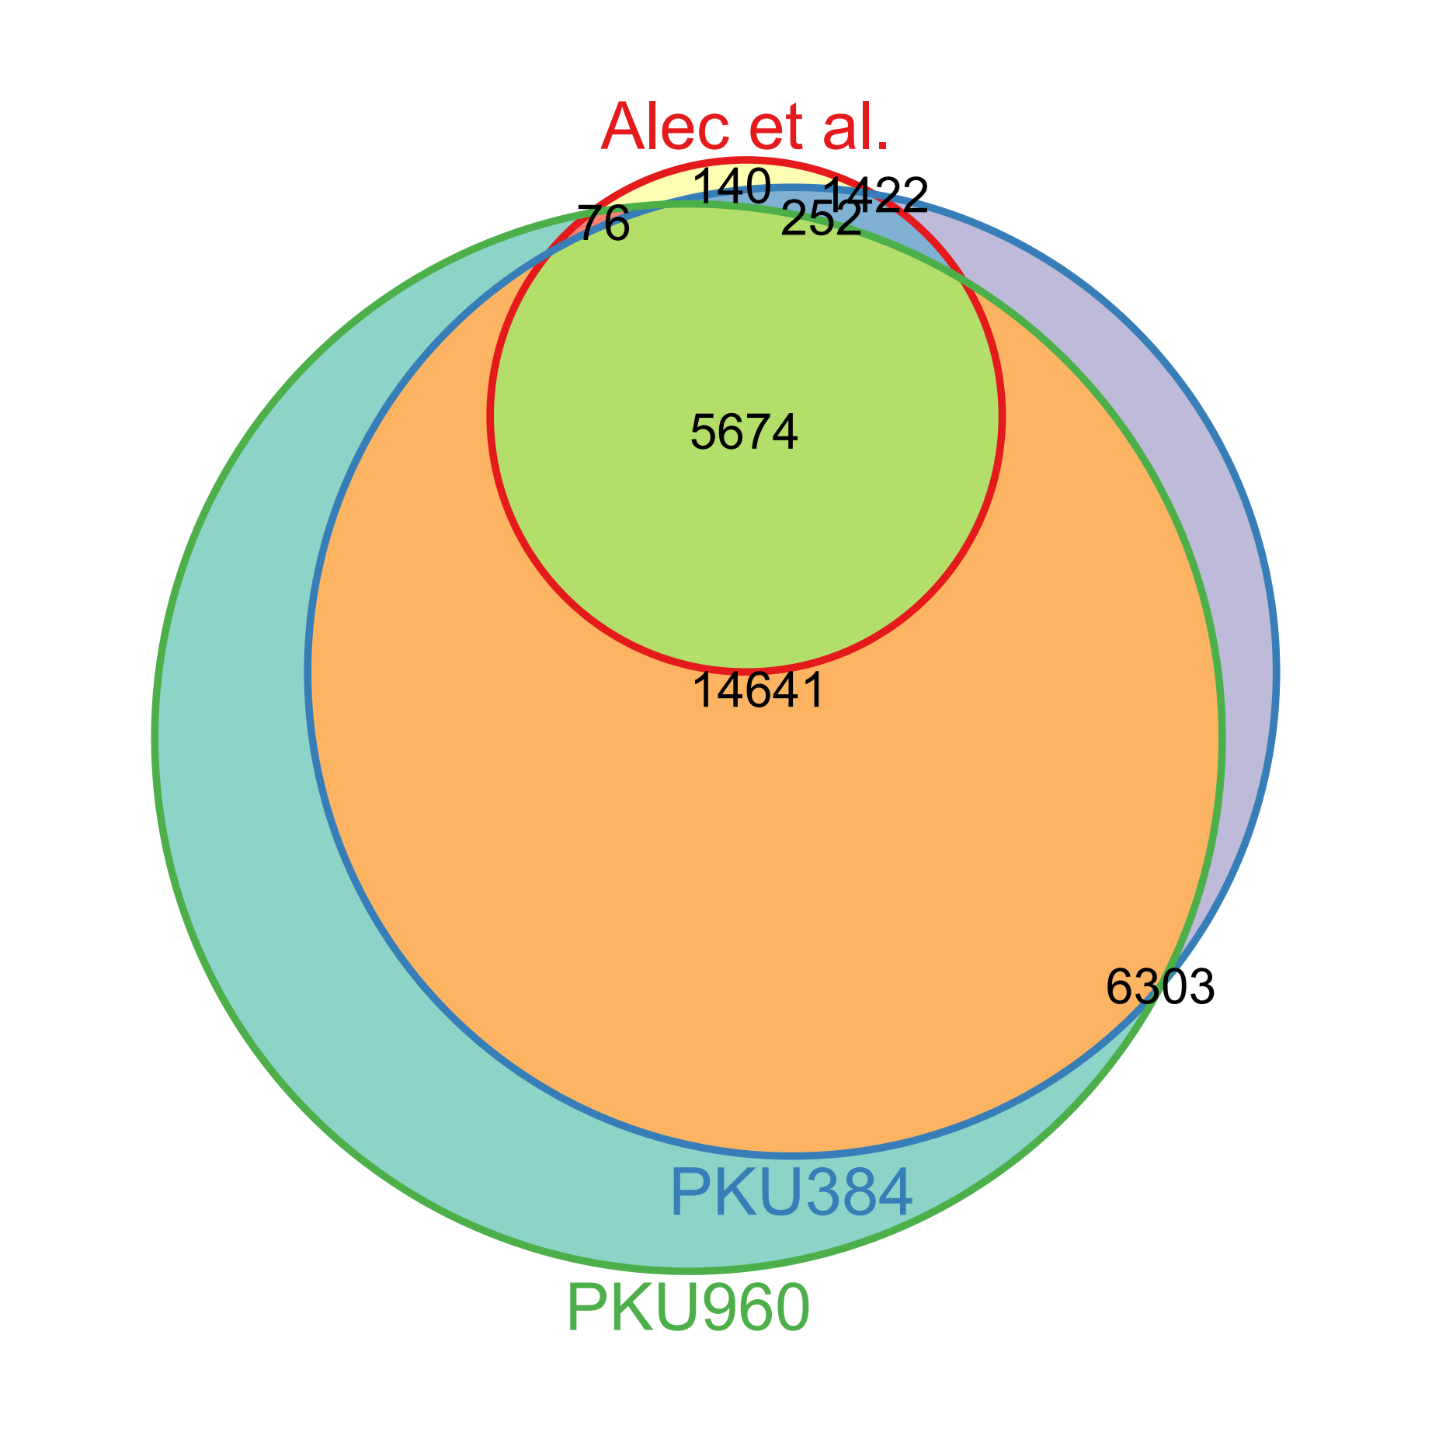
Modules comparison
Dataset | # Total gene | # Gene in module | # Module
Alec et al. | 11303 | 6142 | 174
PKU384 | 22109 | 21989 | 298
PKU960 | 27420 | 26694 | 698
# Gene in module

Slide 31
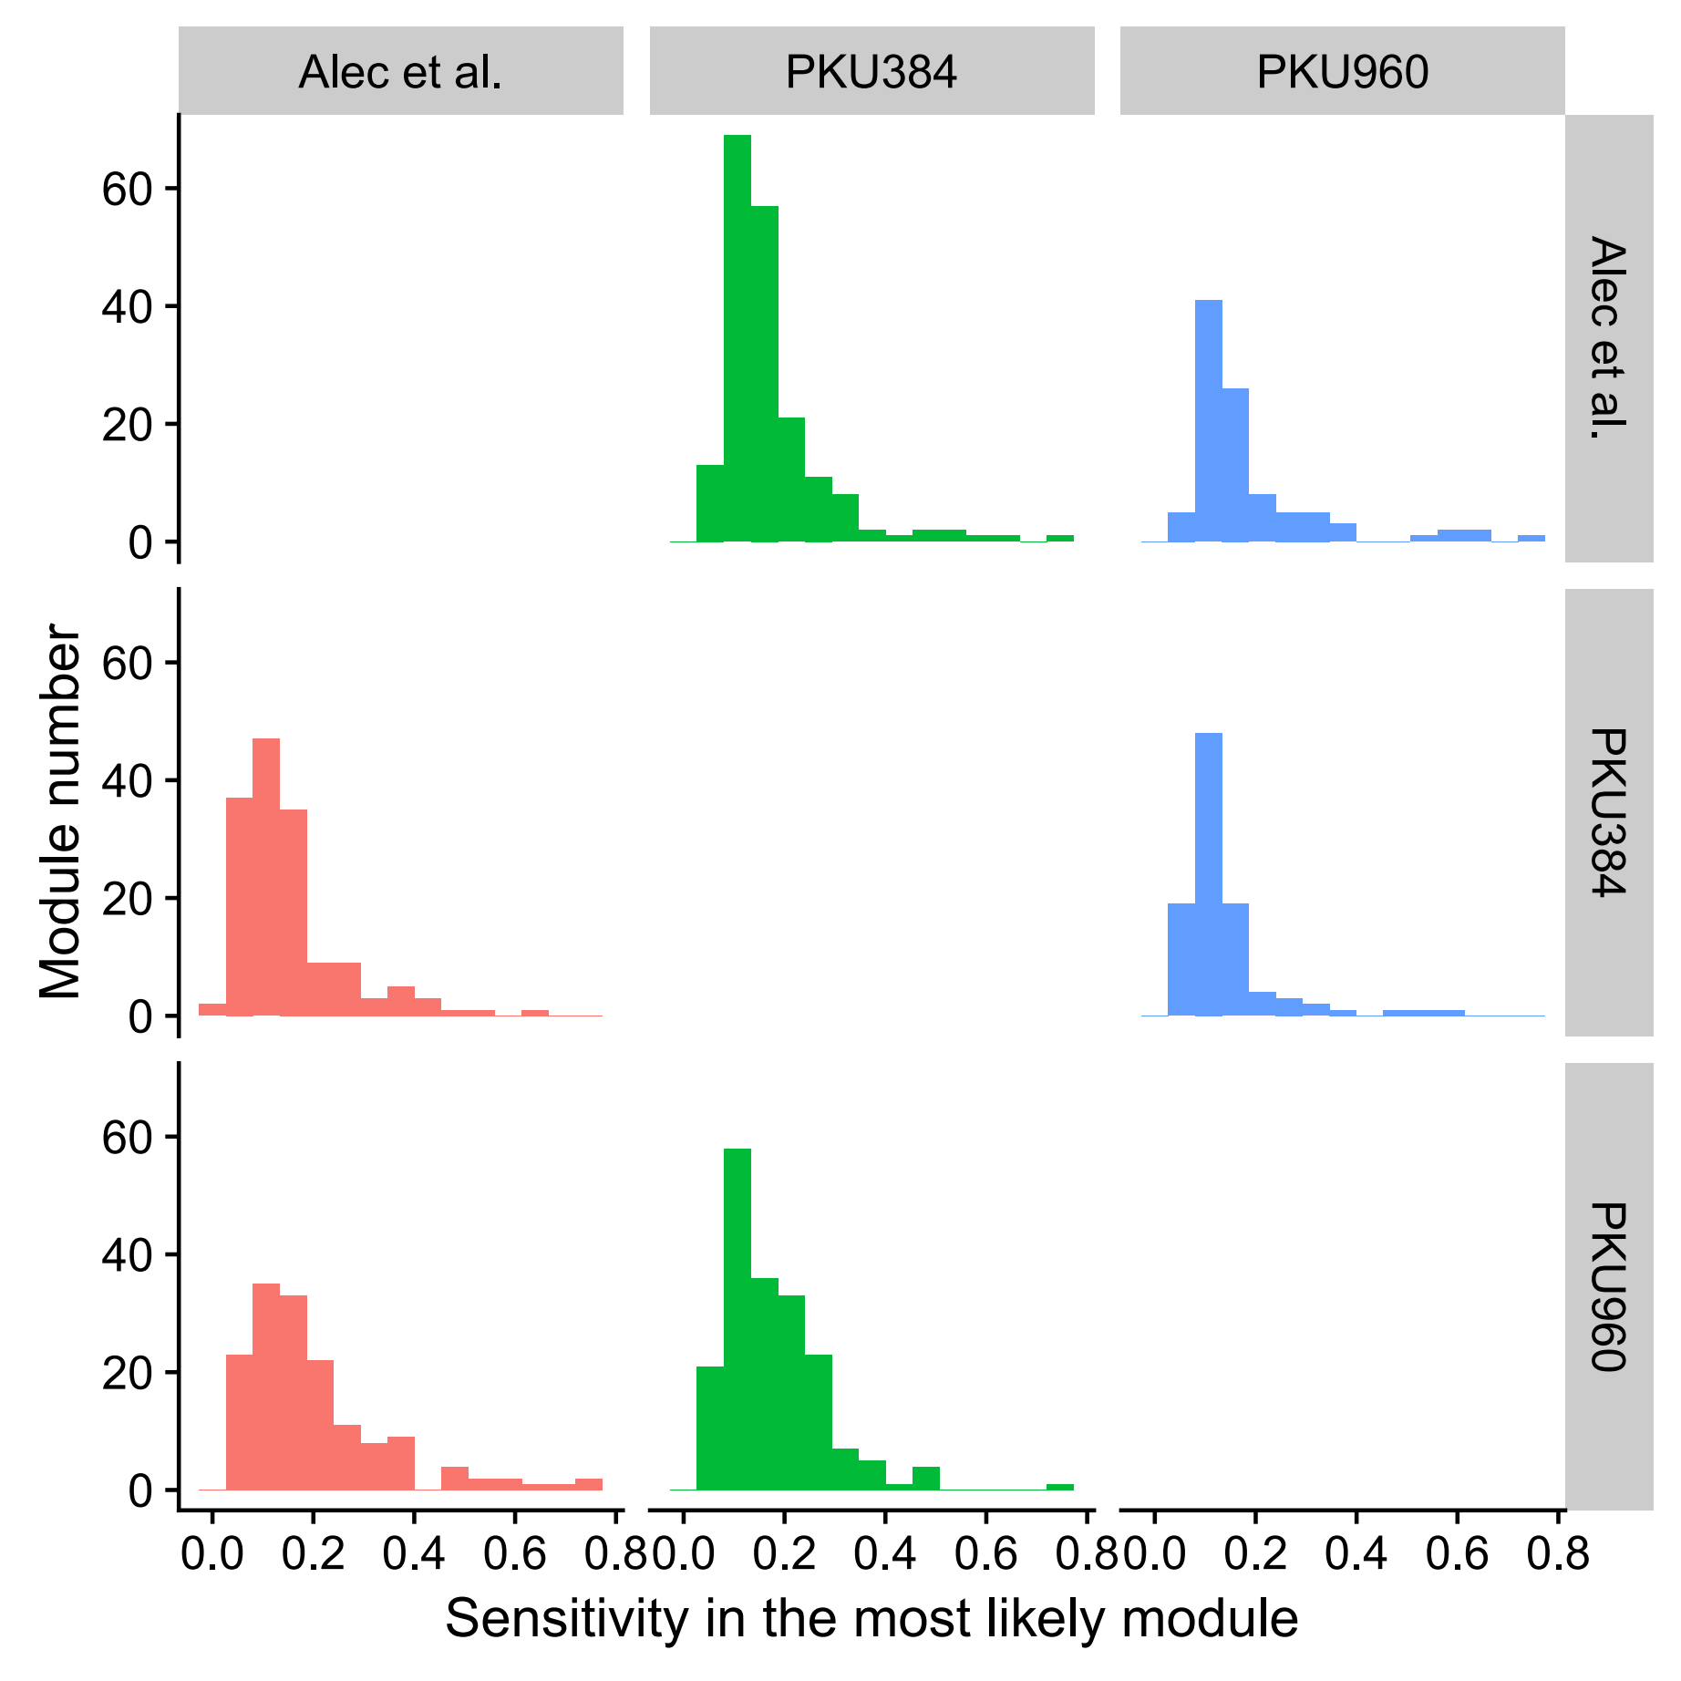
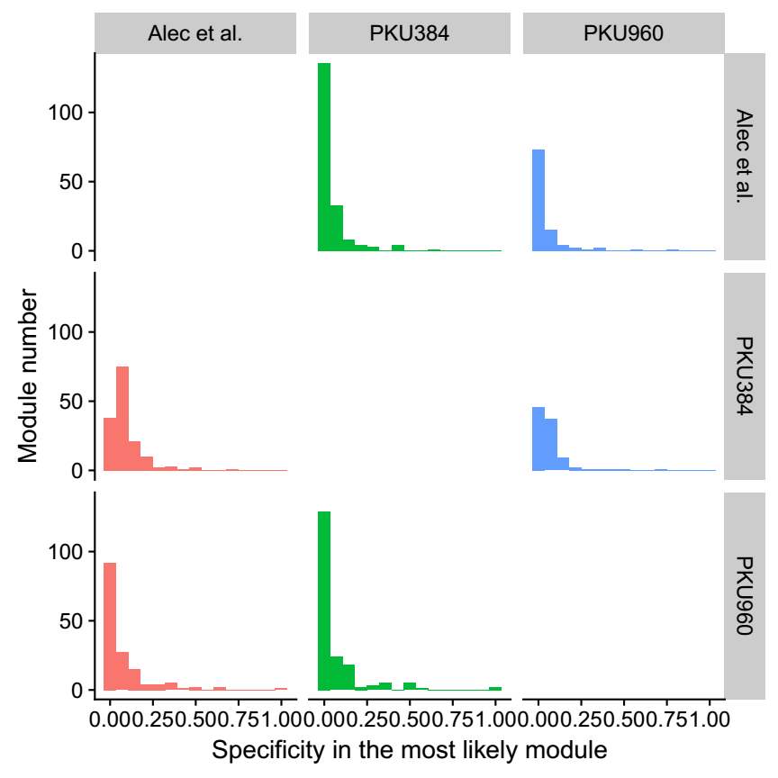
Modules comparison
Most likely
Ratio=2/5
Most likely
Ratio=2/3

Slide 32
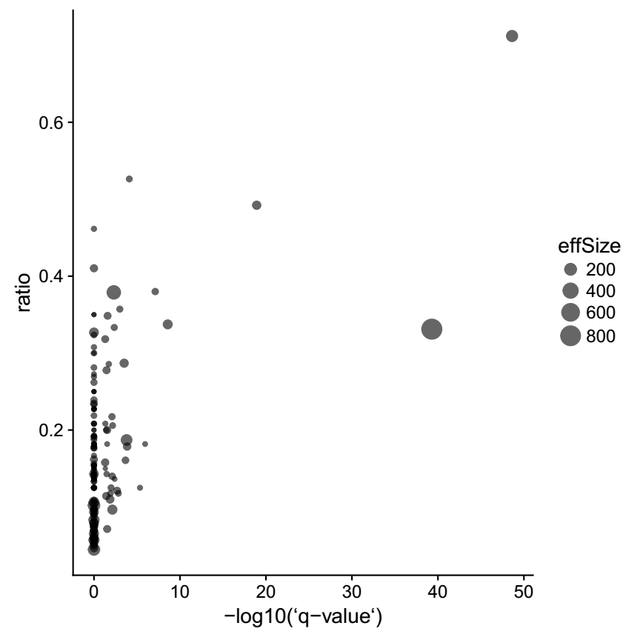
Modules comparison
Most likely
Ratio=2/5

Slide 33
Summary
1. PKU960 dataset shows different expression pattern.
2. Most of modules are not consistent across datasets.
3. The most significant modules are consistent across datasets.

Slide 34
Thanks
Notes:
http://www.nature.com/news/the-human-cell-atlas-from-vision-to-reality-1.22854

